Slide 1


messiah
Natural Disaster Management Application
Team - UX Bulls

Slide 2



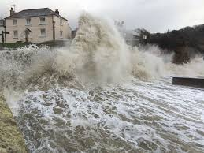
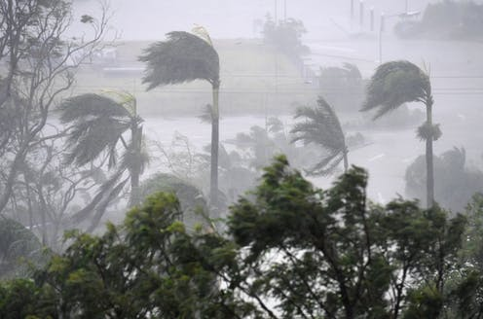
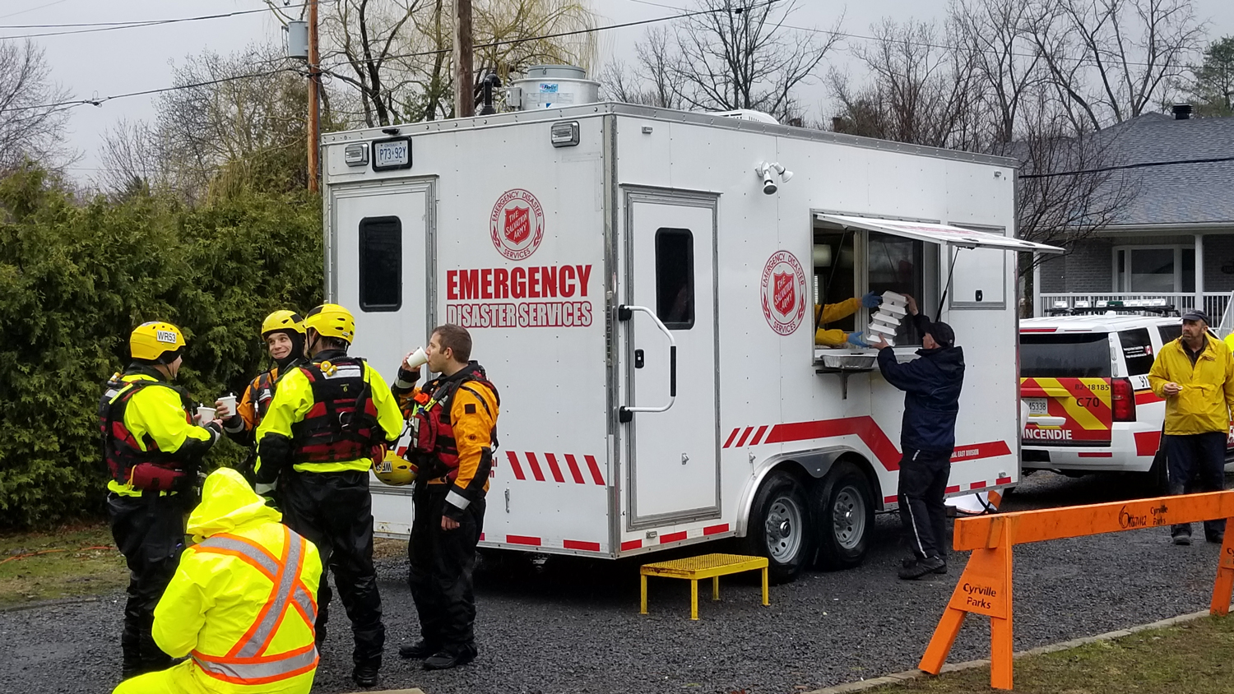
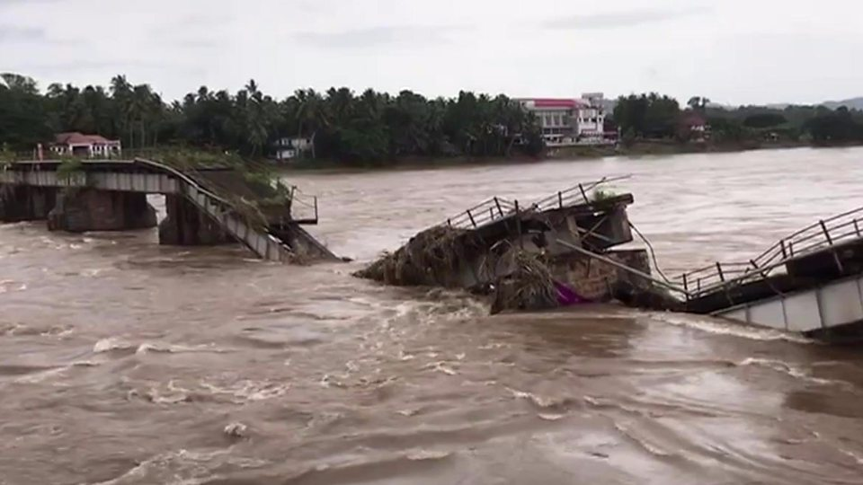
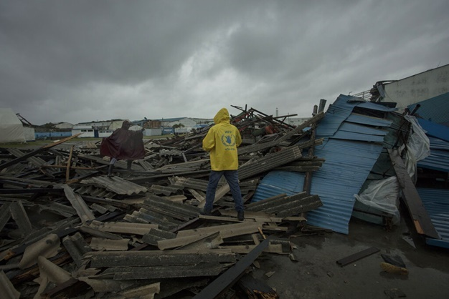



Natural Disaster Management Challenges
Unmanaged disaster rescue operations, lack of real time updates
Victims remain stuck at various places waiting for the disaster teams to reach them and carry out the relief and rescue operations
Unable to fast-track dire needs of users in the aftermath of major disasters e.g. food supplies and medical facilities
Lack of knowledge of shelter homes
Lack of network in the disaster affected zones
Inadequate supply chain as well as lack of information about the stock availability
© 2019 Cognizant

Slide 3
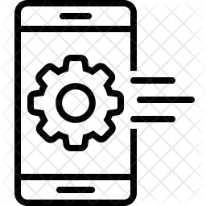






messiah - Our Solution for Natural Disaster Management
Light Weight Mobile App
Light Weight Wi-Bot
Light weight mobile application for victims and admins to monitor the disaster and the alerts system
Mobile application can be hosted and downloaded from the app store of corresponding platforms
Light weight Wi-Bot to ensure strong network dedicated to the messiah application in no network zones
Internet of Things
Mobile Application
messiah
Messiah Server (IoT Device)
Centralized Tracking
Network of Things
IBM Cloud Server
Centralized tracking of various incidents, real time updates and distress messages
Mobile messiah server acts as ISP to the Wi-Bots and creates a mesh of Wi-Bots to cover big networks
© 2019 Cognizant

Slide 4






messiah Feature List
Post disaster – Providing the users with smart navigation option to save themselves from the disaster affected zones and shift to safe shelters
Low cost, low powered efficient IoT WiFi network mesh to provide a dedicated network for the messiah application so that users can connect to the network via mobile application and send distress messages
Messiah
Smart
Connect
Automate
Analyze
Efficient
Predict
Pre-disaster prediction of flood and cyclone followed by alerting the user in case of the disaster occurrence
AI classification of the weather alerts and showing the user with proper UX pattern to create awareness
AI Community forum to classify the distress incidents reported by the users
AI support via chat bot to deploy help at the location of the triggered distress signal
Weather map to give users real-time updates
Future Automation - Create organization structure to classify the available resources like doctors and social workers and deployment of the required teams based on the distress signal NLP analysis
© 2019 Cognizant

Slide 5







messiah Architecture
Weather API Server
Weather API
Alert Service
User
Rest API
IBM Cloud Server
Messiah
Wi-bot
Satellite image data
IBM Cloud DB2
© 2019 Cognizant

Slide 6
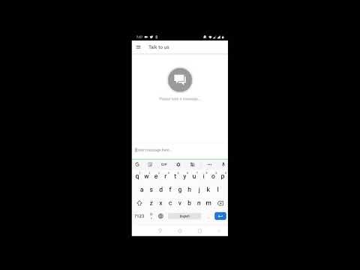

Solution Demonstration
© 2019 Cognizant

Slide 7
Thank you
UX Bulls

